Slide 1
Greedy Algorithms

Slide 2
Optimization problems
An optimization problem is one in which you want to find, not just a solution, but the best solution
A “greedy algorithm” sometimes works well for optimization problems
A greedy algorithm works in phases. At each phase:
  You take the best you can get right now, without regard for future consequences
  You hope that by choosing a local optimum at each step, you will end up at a global optimum
3

Slide 3
Greedy Algorithms
Acitivity Selection Problem
Fractional Kanpsack
Huffman Code
Minimum number of processors to run activities
Minimise delay
Maximum Independent Set in a tree
Min Coin Change
4

Slide 4
An Activity Selection Problem
Input: A set of activities S = {a₁,…, a_{n}}
Each activity has start time and a finish time
  a_{i}=(s_{i}, f_{i})
Two activities are compatible if and only if their interval does not overlap
Output: a maximum-size subset of mutually compatible activities

Slide 5
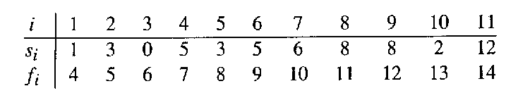
The Activity Selection Problem
Here are a set of start and finish times
What is the maximum number of activities that can be completed?
  {a₃, a₉, a₁₁} can be completed
  But so can {a₁, a₄, a_{8’} a₁₁} which is a larger set
  But it is not unique, consider {a₂, a₄, a_{9’} a₁₁}

Slide 6
Early Finish Greedy
Select the activity with the earliest finish
Eliminate the activities that could not be scheduled
Repeat!

Slide 7
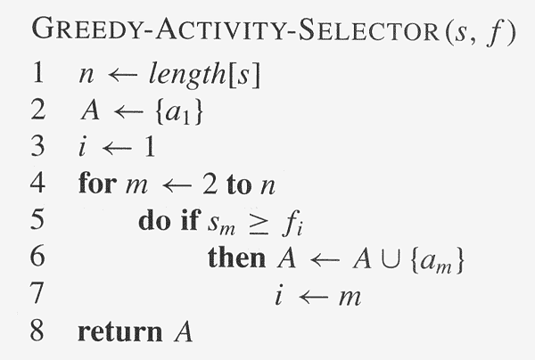
Assuming activities are sorted by finish time

Slide 8
Why it is Greedy?
Greedy in the sense that it leaves as much opportunity as possible for the remaining activities to be scheduled
The greedy choice is the one that maximizes the amount of unscheduled time remaining

Slide 9
Why this Algorithm is Optimal?
We will show that this algorithm uses the following properties
  The problem has the optimal substructure property
  The algorithm satisfies the greedy-choice property
Thus, it is Optimal

Slide 10
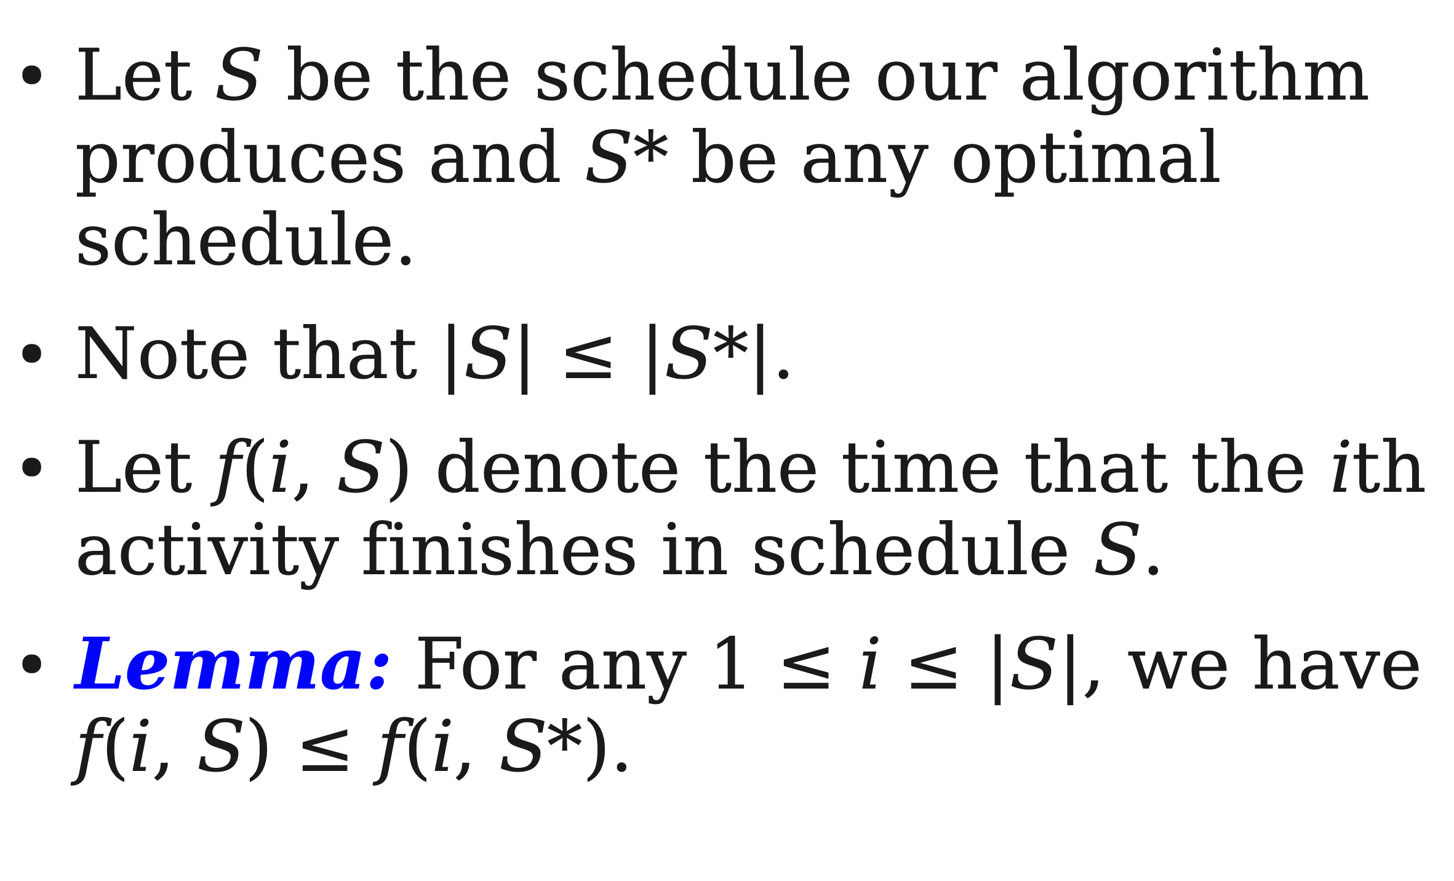

Slide 11
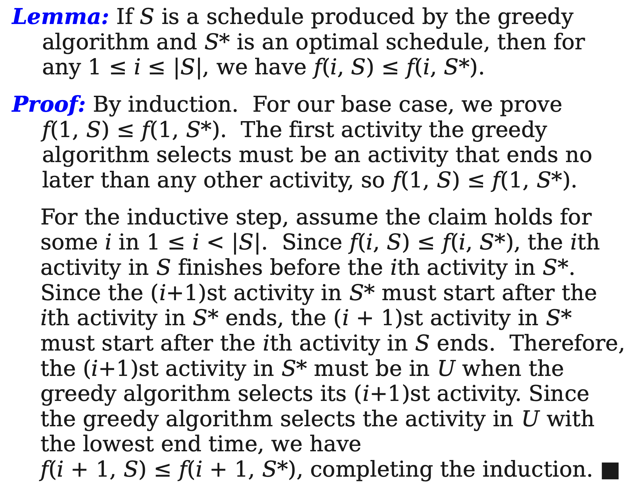

Slide 12
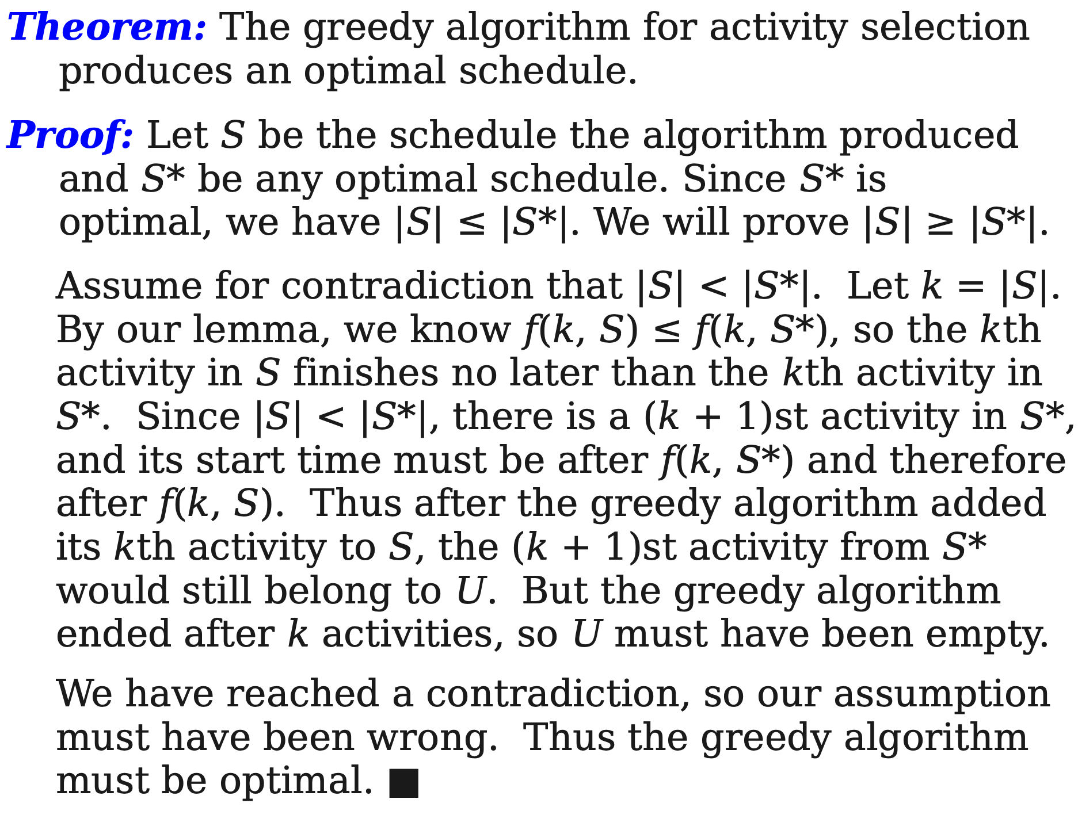

Slide 13
Greedy attempts
Select the activity with the earliest start time
With smallest interval
With minimum overlap

Slide 14
Greedy attempts
Select the activity with the earliest start time first activity overlaps all other activities where all other activities occur in sequence one starting after other finishes.
With smallest job interval
Activityi StartTime FinishTime Duration Soln derived {1}. Ans:{2,3}
1 3 5 2
2 1 4 3
3 4 7 3
With minimum overlap
Activityi StartTime FinishTime # of overlaps
1 3 5 2
2 0 2 2
3 6 8 2
4 2 4 3
5 4 6 3
6 1 3 3
7 1 3 3
8 5 7 3
9 5 7 3
The solution derived from this approach is{1,2,3}, but he optimal solution should be{2,3,4,5}

Slide 15
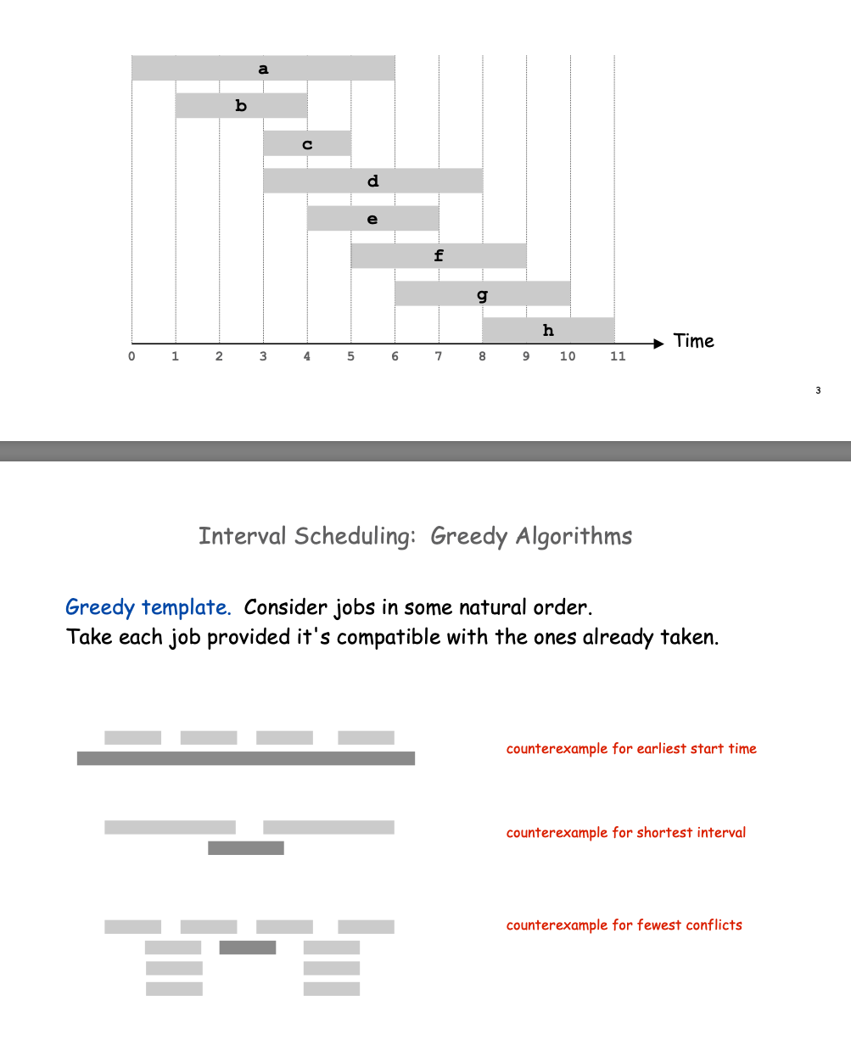

Slide 16
Optimal Substructures
  Once the greedy choice of activity 1 is made, the problem reduces to finding an optimal solution for the activity-selection problem over those activities in S that are compatible with activity 1
    Optimal Substructure
    If A is optimal to S, then A’ = A – {1} is optimal to S’={i ∈S: s_{i} ≥ f₁}
    Why?
      If we could find a solution B’ to S’ with more activities than A’, adding activity 1 to B’ would yield a solution B to S with more activities than A ➔ contradicting the optimality of A
  After each greedy choice is made, we are left with an optimization problem of the same form as the original problem
    By induction on the number of choices made, making the greedy choice at every step produces an optimal solution

Slide 17
Elements of Greedy Strategy
An greedy algorithm makes a sequence of choices, each of the choices that seems best at the moment is chosen
  NOT always produce an optimal solution
Two ingredients that are exhibited by most problems that lend themselves to a greedy strategy
  Greedy-choice property
  Optimal substructure

Slide 18
Fractional Knapsack Problem
In fractional knapsack problem, where we are given a set S of n items, s.t., each item I has a positive benefit b_{i} and a positive weight w_{i}, and we wish to find the maximum-benefit subset that doesn’t exceed a given weight W.
We are also allowed to to take arbitrary fractions of each item.

Slide 19
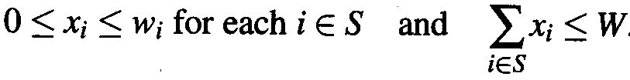

Fractional Knapsack Problem
I.e., we can take an amount x_{i} of each item i such that
The total benefit of the items taken is determined by the objective function

Slide 20
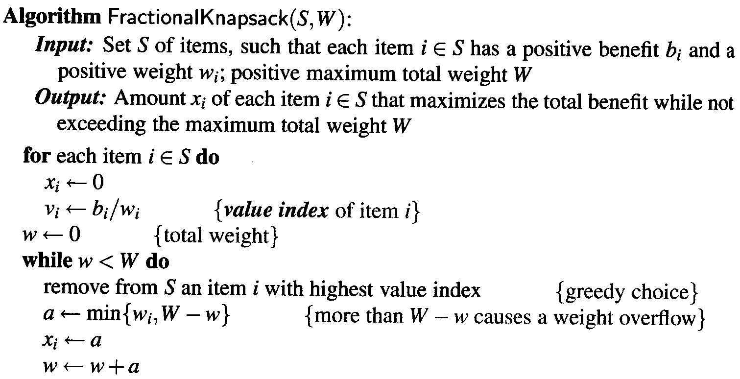
Fractional Knapsack Problem

Slide 21
The Fractional Knapsack Algorithm
Greedy choice: Keep taking item with highest value (benefit to weight ratio)
  Run time: O(n log n). Why?
Correctness: Suppose there is a better solution
  there is an item i with higher value than a chosen item j, but x_{i}<w_{i}, x_{j}>0 and v_{i}<v_{j}
  If we substitute some i with j, we get a better solution
  How much of i: min{w_{i}-x_{i}, x_{j}}
  Thus, there is no better solution than the greedy one

Slide 22
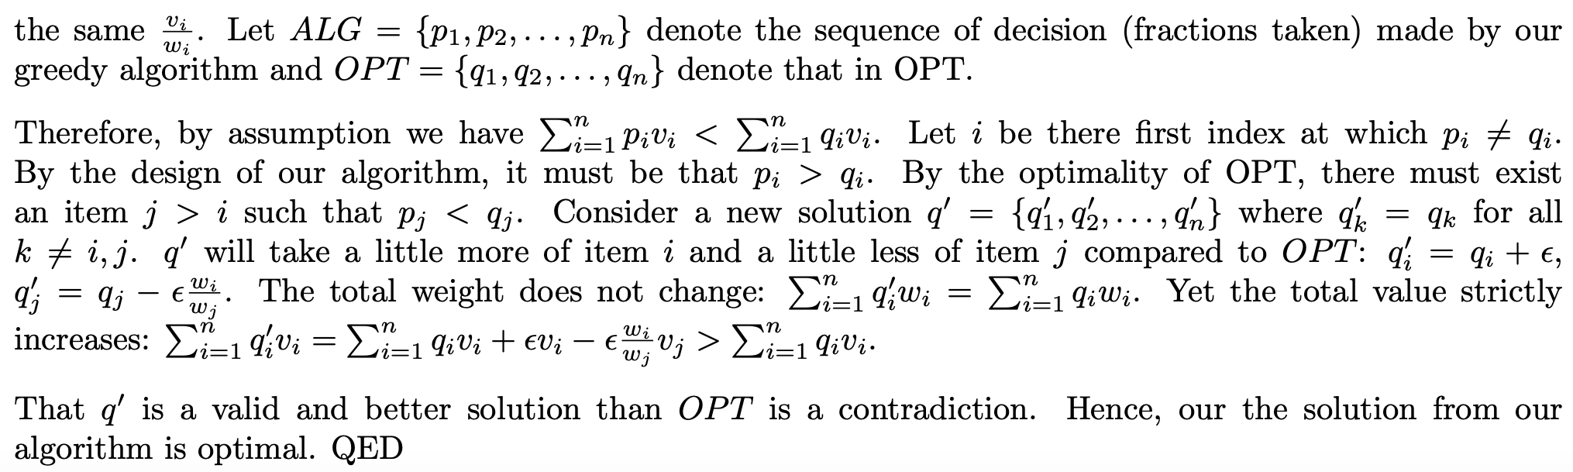

Slide 23
Interval Scheduling
Suppose we are given a set T of n classes that need to be held, s.t., each class i has a start time s_{i} and a completion time f_{i}.
Each class has to be performed in a classroom and each classroom can obviously hold only one class at a time.
Two tasks i and j are non-conflicting if fi ≤ sj or fj ≤ si.
Two tasks can be executed in the classroom only if they are non-conflicting.
The interval scheduling problem is to schedule all the tasks in T in the fewest classrooms possible in a non-conflicting way
23

Slide 24
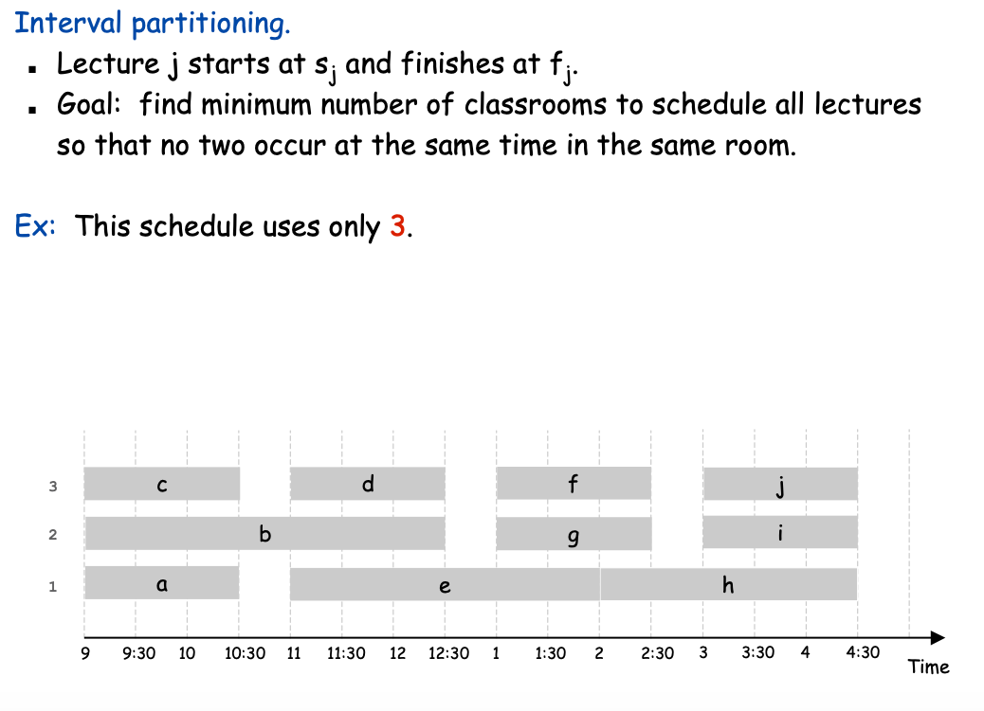
Interval Scheduling

Slide 25
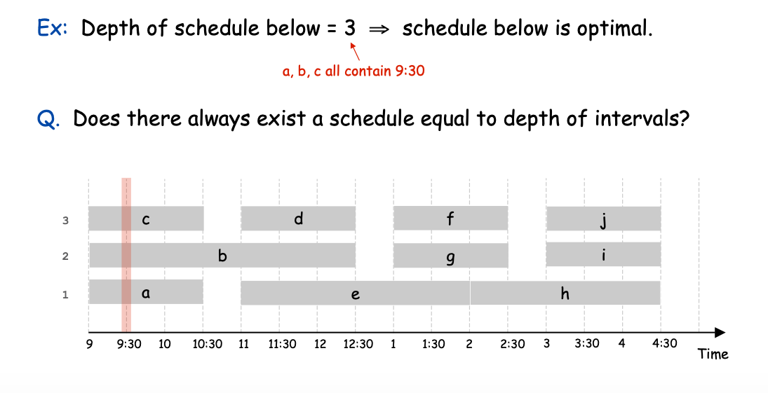
Interval Scheduling

Slide 26
What ordering will allow greedy ?
Increasing Start Time —counter example
Min conflicting — counter example
Increasing Finish Time : Two algorithms shown in class the better of which is O(n log n)

Slide 27
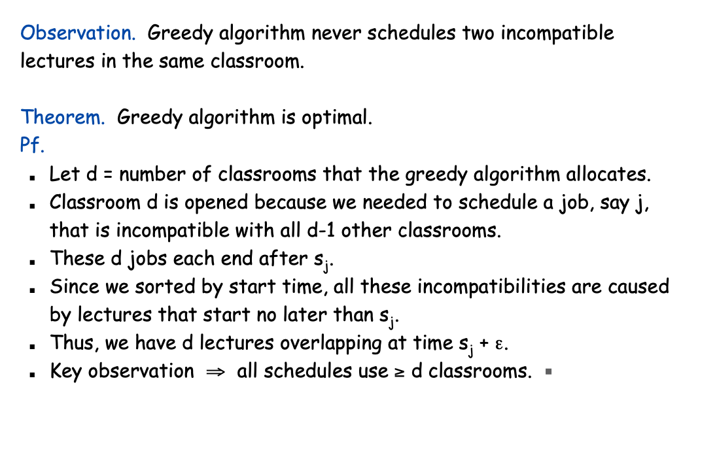

Slide 28
Min Coin Change
A=12: S={1,5,10}.
A=12: S={1,6,10}.
44

Slide 29
Min Coin Change
The greedy choice: max{di in denominations|di<=A}
Subproblem: c(A-di}
A=12: S={1,5,10}. Greedy works here
A=12: S={1,6,10}. Greedy does not work here.
For the set S={1,5,10}; how to make any denomination with minimum number of coins
44

Slide 30
Min Coin Change
The greedy choice: max{di in denominations|di<=A}
Subproblem: c(A-di}
A=12: S={1,5,10}
Let O(A)be optimal and O(A) does not follow greedy
Strategy. Then;
For A>=10 and optimal has one or more 10’s less than greedy. We show that O(A) is not optimal. For the missing 10 if A) O(A) has only 1’s: Contradiction. Replace 10 1’s with 10
B) O(A) has one 5. Contradiction. Replace 5 1’s with a 5
C)O(A) has multiple 5’s. Contradiction. Replace 2 5’s with a 10.
For 5<=A<10
Only 1’s: Contradiction . Replace 5 1’s with 5
Thus Optimal has to be following greedy.
45

